Slide 1
Chapter 3
Divide-and-Conquer

Slide 2
MaxMin Algorithm
MaxMin(i, j, max, min)
{
if (i=j) then max := min := a[i]; //Small(P)
else if (i=j-1) then // Another case of Small(P)
{
if (a[i] < a[j]) then max := a[j]; min := a[i];
else max := a[i]; min := a[j];
}
else
{
// if P is not small, divide P into sub-problems. Find where to split the set.
mid := ( i + j )/2; // Solve the sub-problems.
MaxMin( i, mid, max, min );
MaxMin( mid+1, j, max1, min1 );
// Combine the solutions.
if (max < max1) then max := max1;
if (min > min1) then min := min1;
}
}

Slide 3
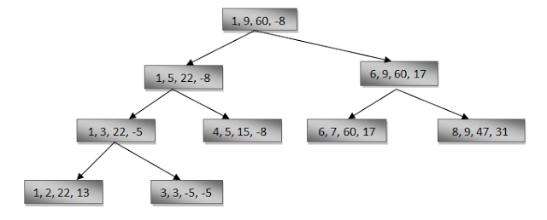
A simple example
Finding the maximum and minimum of a set S of n numbers

Slide 4
Time complexity
T(n)=2T(n/2)+2T(n/2)+2 if n>=2
=1 if n=2
=0 if n=1
Calculation of T(n):
Assume n = 2^{k},
T(n) = 2T(n/2)+2
= 2(2T(n/4)+2)+2
= 4T(n/4)+4+2
:
=2^{k-1}T(2)+2^{k}-2
=3n/2-2

Slide 5
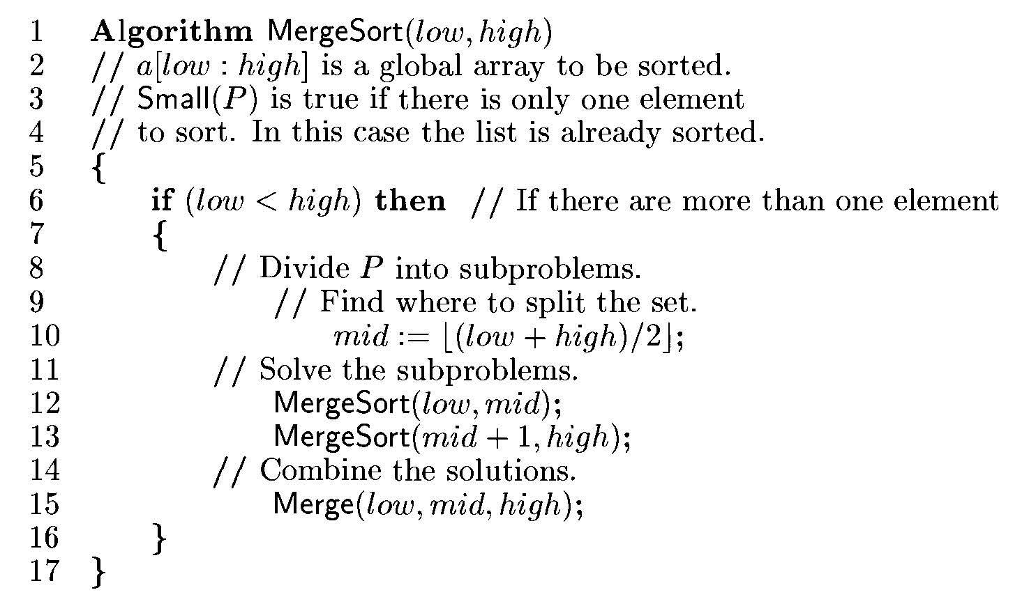
Merge Sort

Slide 6
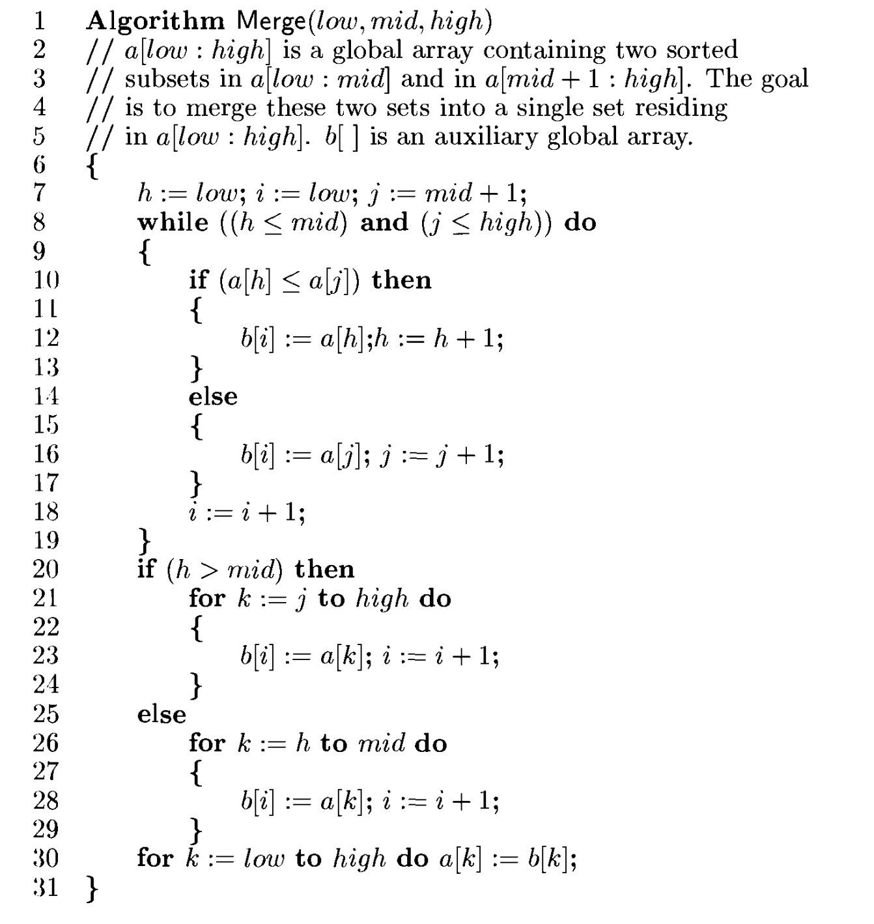
Algorithm: Merge Element

Slide 7
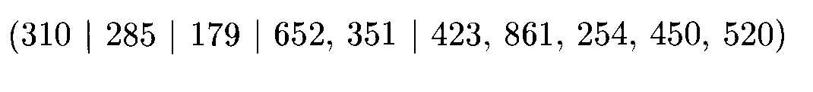
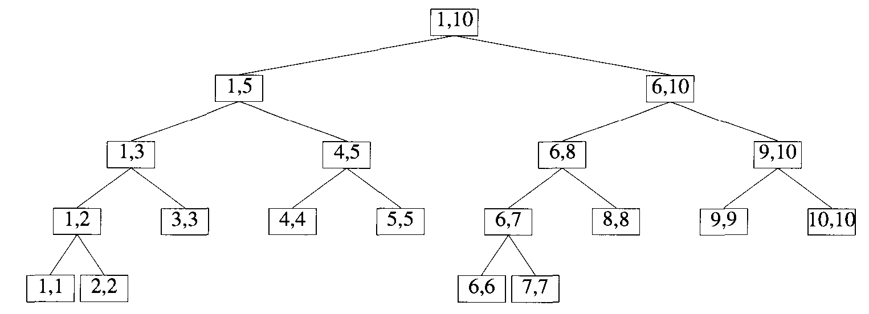
Tree of Calls of Merge Sort

Slide 8
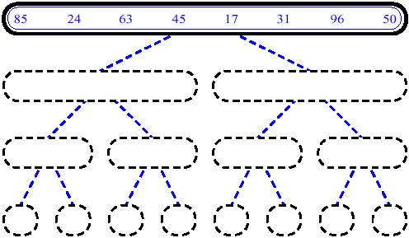
Merge Sort (Example) Cont..

Slide 9
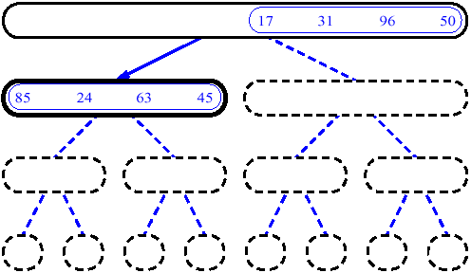
Merge Sort (Example) Cont..

Slide 10
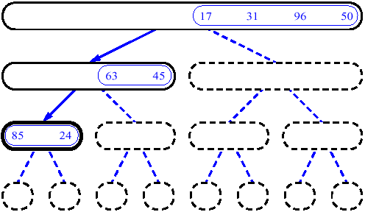
MergeSort (Example) Cont..

Slide 11
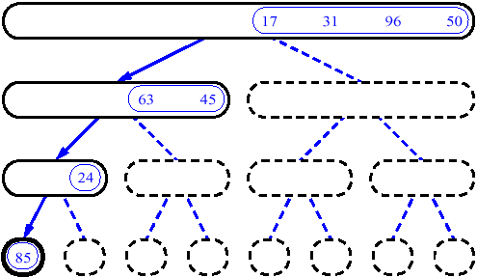
MergeSort (Example) Cont..

Slide 12
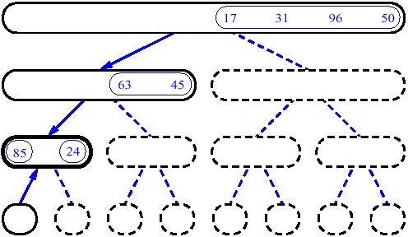
MergeSort (Example) Cont..

Slide 13
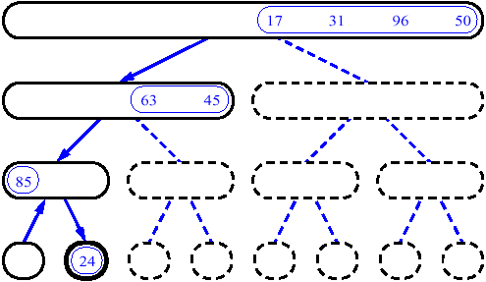
MergeSort (Example) Cont..

Slide 14
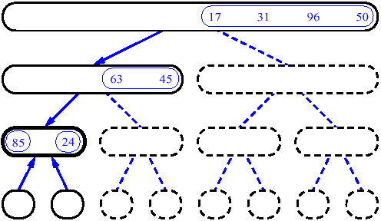
MergeSort (Example) Cont..

Slide 15
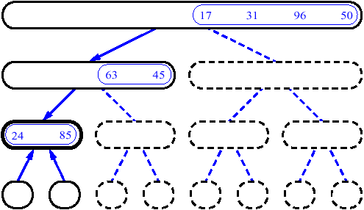
MergeSort (Example) Cont..

Slide 16
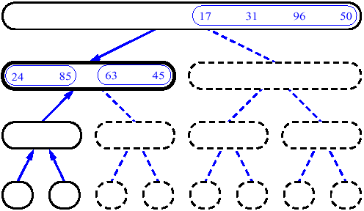
MergeSort (Example) Cont..

Slide 17
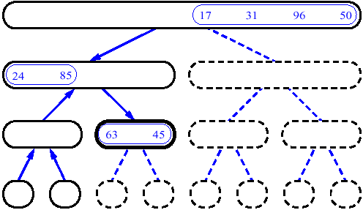
MergeSort (Example) Cont..

Slide 18
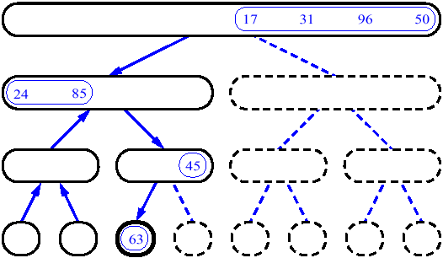
MergeSort (Example) Cont..

Slide 19
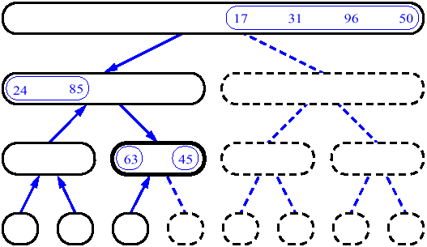
MergeSort (Example) Cont..

Slide 20
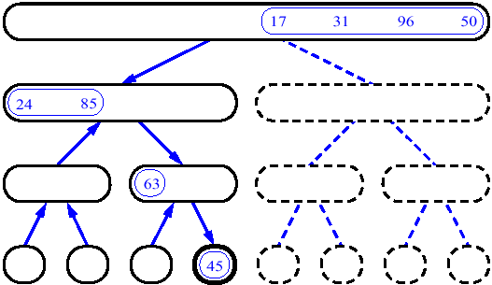
MergeSort (Example) Cont..

Slide 21
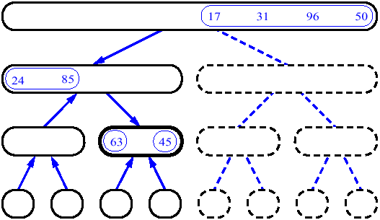
MergeSort (Example) Cont..

Slide 22
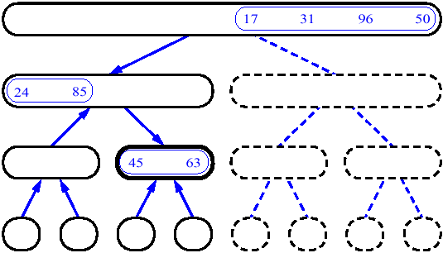
MergeSort (Example) Cont..

Slide 23
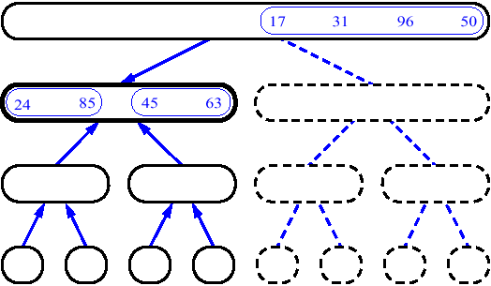
MergeSort (Example) Cont..

Slide 24
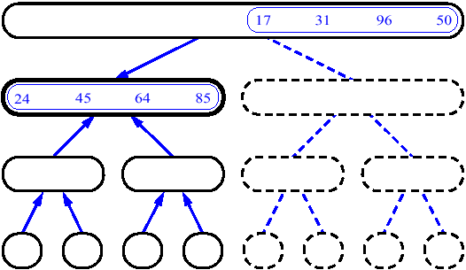
MergeSort (Example) Cont..

Slide 25
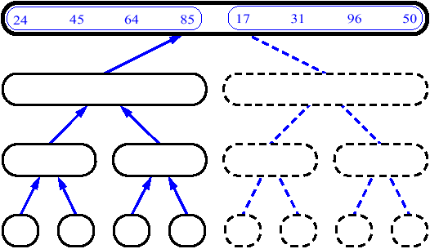
MergeSort (Example) Cont..

Slide 26
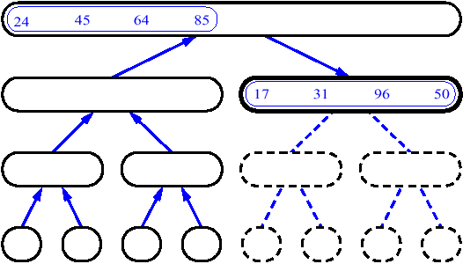
MergeSort (Example) Cont..

Slide 27
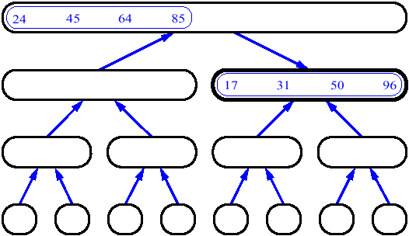
MergeSort (Example) Cont..

Slide 28
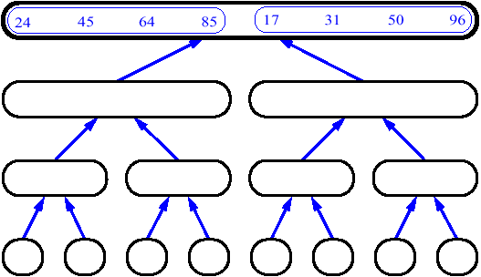
MergeSort (Example) Cont..

Slide 29
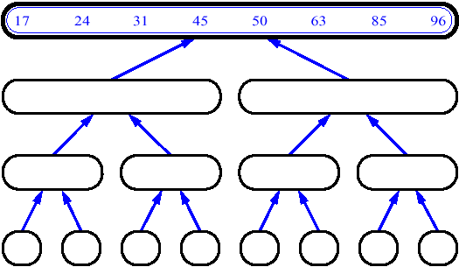
MergeSort (Example) Cont..

Slide 30
Merge
14
23
45
98
6
33
42
67

Slide 31
Merge
14
23
45
98
6
33
42
67

Slide 32
Merge
14
23
45
98
6
33
42
67
6

Slide 33
Merge
14
23
45
98
6
33
42
67
6
14

Slide 34
Merge
14
23
45
98
6
33
42
67
6
14
23

Slide 35
Merge
14
23
45
98
6
33
42
67
6
14
23
33

Slide 36
Merge
14
23
45
98
6
33
42
67
6
14
23
33
42

Slide 37
Merge
14
23
45
98
6
33
42
67
6
14
23
33
42
45

Slide 38
Merge
14
23
45
98
6
33
42
67
6
14
23
33
42
45
67

Slide 39
Merge
14
23
45
98
6
33
42
67
6
14
23
33
42
45
67
98

